Slide 1


Data Analysis for Social Buzz

Slide 2


Today's agenda
Project recap
Problem
The Analytics team
Process
Insights
Summary

Slide 3

Social Buzz a content focused start-up has reached over 500 million active users each month.
They have scaled quicker than anticipated and need the help of an advisory firm to oversee their scaling process effectively.
To start our engagement with Social Buzz, we are running a 3-month initial project. They are expecting the following:
An audit of their big data practice
Recommendations for a successful IPO
An analysis of their content categories that highlights the top 5 categories with the largest aggregate popularity
Project Recap

Slide 4

Due to their rapid growth and digital nature of their core product:
Huge amount of data generated every day.
over 100,000 pieces of content, ranging from text, images, videos and GIFs are posted.
Highly unstructured data and requires extremely sophisticated and expensive technology to manage and maintain.
Not enough employees to maintain this highly complex technology.
Problem

Slide 5



Chief Technology Architect
Andrew Fleming
The Analytics team
Senior Principal
Marcus Rompton
Data Analyst
Priyanka Katre

Slide 6
Data Understanding
Process
1
Data cleaning
2
Data Modelling
3
Data Analysis
4
Uncover Insights
5

Slide 7

Insights
How many unique categories are there?
- 16 unique categories
How many reactions are there to the most popular category?
- 1897 reactions on Animals.
What was the month with the most posts?
- January 2021 with most posts (1708 posts).

Slide 8
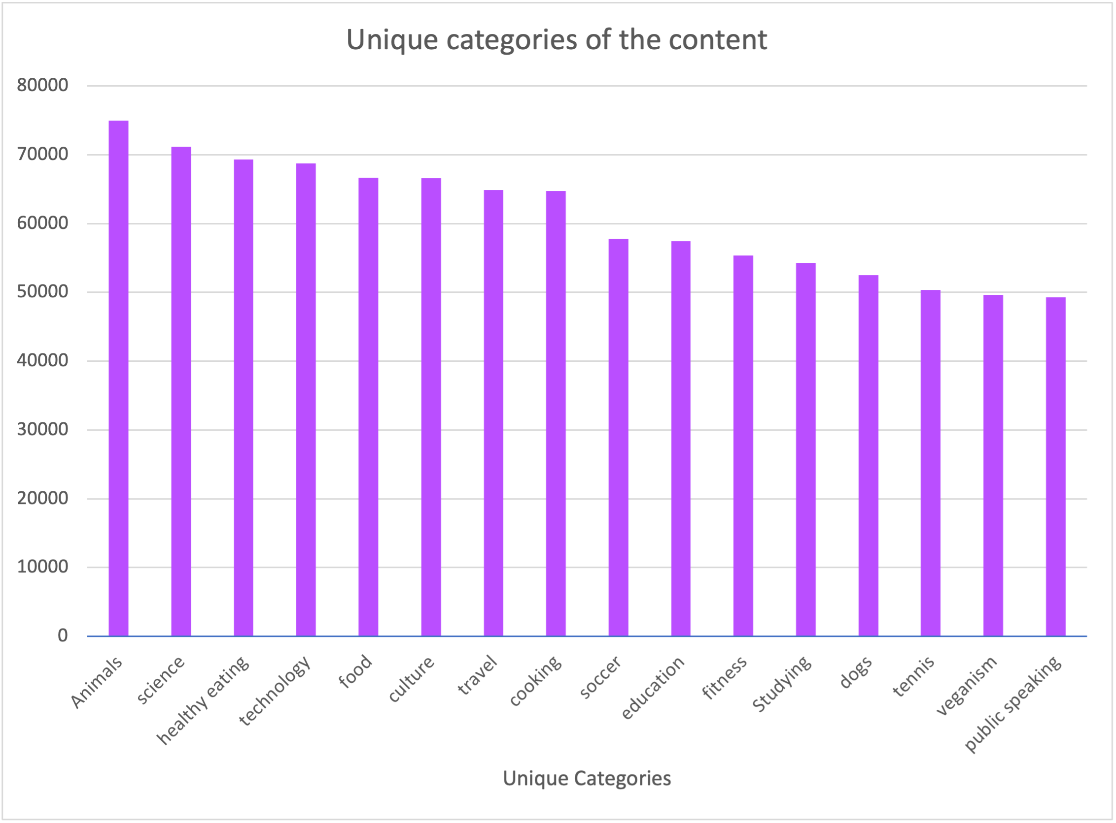
16 unique categories available for the content

Slide 9
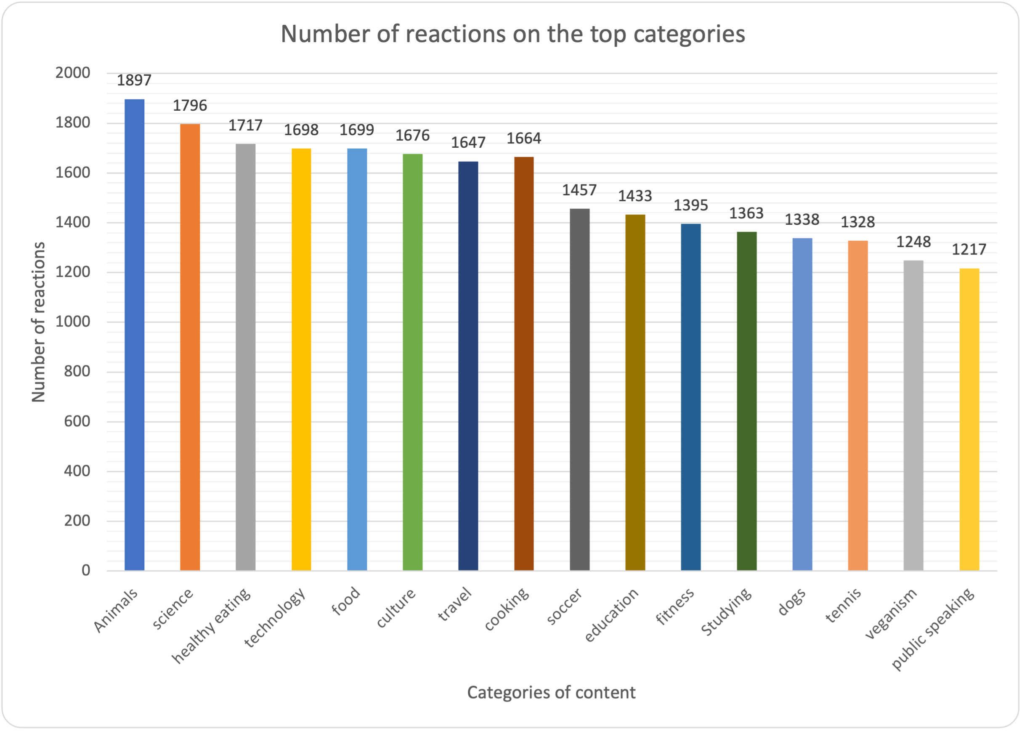
1897 reactions on the most popular category Animals

Slide 10
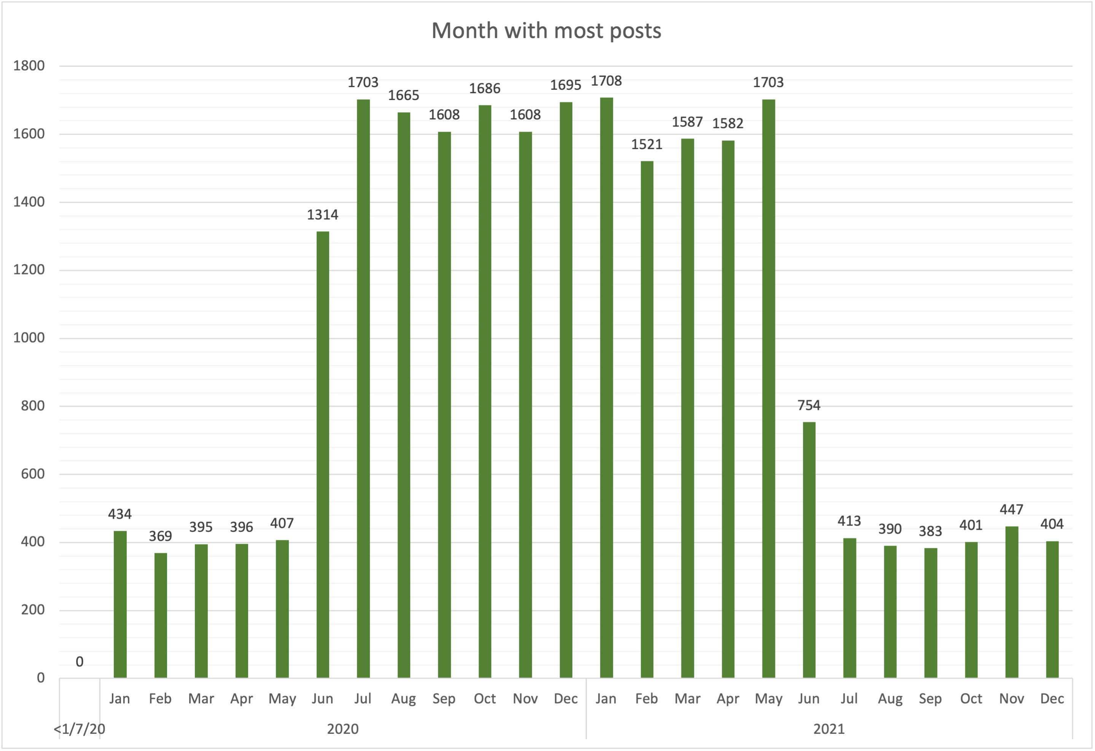
January 2021 is the month with most posts (1708 posts)

Slide 11

We can see Animals, Science followed by Healthy eating and technology are the most popular content within the users, which means the customer that are using Social Buzz are more intellectual people.
Summary
It is evident by looking at Animal content that pet parents are using this platform a lot, it could be to post their pet’s pictures which can be a good source of income for them like Instagram or YouTube.
By looking at the data we can tell that January and December has been the month when there was more activity. The reason could be the holiday season, when users have a lot to share with friends and family.

Slide 12

Thank you!
ANY QUESTIONS?

